Slide 1
Lactobacilli with its impact in oral cavity
Lecturer Reham M.M. AL-Mosawi
Medical Microbiology (Bacteriology)
Lec.Part 2

Slide 2
Subsequent researches have shown that they are associated more with carious dentine and the advancing front of caries lesions rather than with the initiation of the disease.
Usually lactobacilli comprise less than 1% of the total cultivable microflora. However, their proportions and prevalence may increase at advanced caries lesions both of the enamel and of the root surface.

Slide 3
Etiology and Pathophysiology, continued
The following factors contribute to demineralization:
High cariogenic bacterial load
Frequent feedings
Poor oral hygiene
Decreased saliva production
Notes:
Notes:
A high oral bacterial load results in more acid production.
Frequent feedings allow less time for remineralization.
Poor oral hygiene increases plague and allows sugar to remain longer.

Slide 4
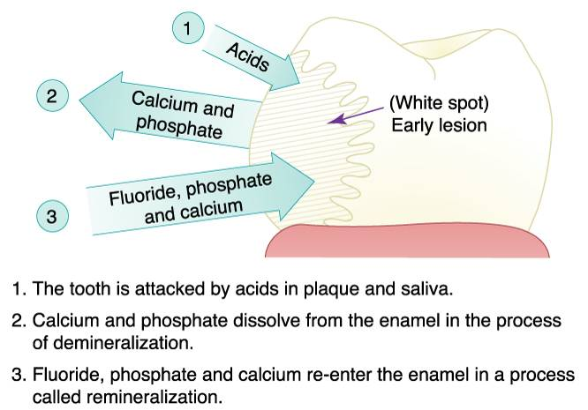
Fig. 10: Dental caries

Slide 7
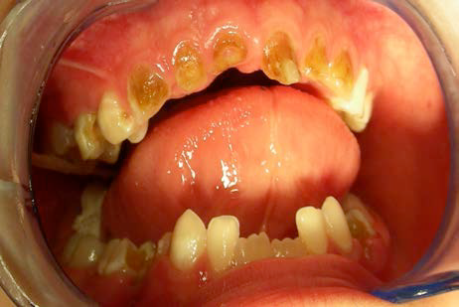
Childhood"
Caries"
Root caries

Slide 9
Thank you!

